Slide 1



Data Science
Explanations about how to do the first and second phases of the final project of the data science course
University of Tehran Spring 2024
Mohammad Amanlou Amir Mahdi Farzaneh Shahzad Momayez

Slide 2


Data Scraping

Slide 3

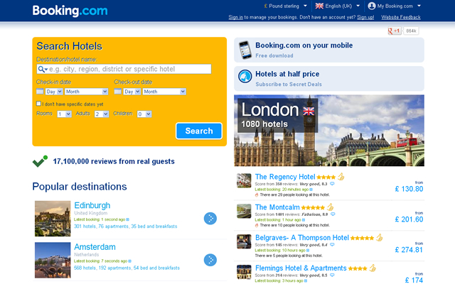
Data Scraping
We used www.booking.com
Contains reservation information of hotels

Slide 4

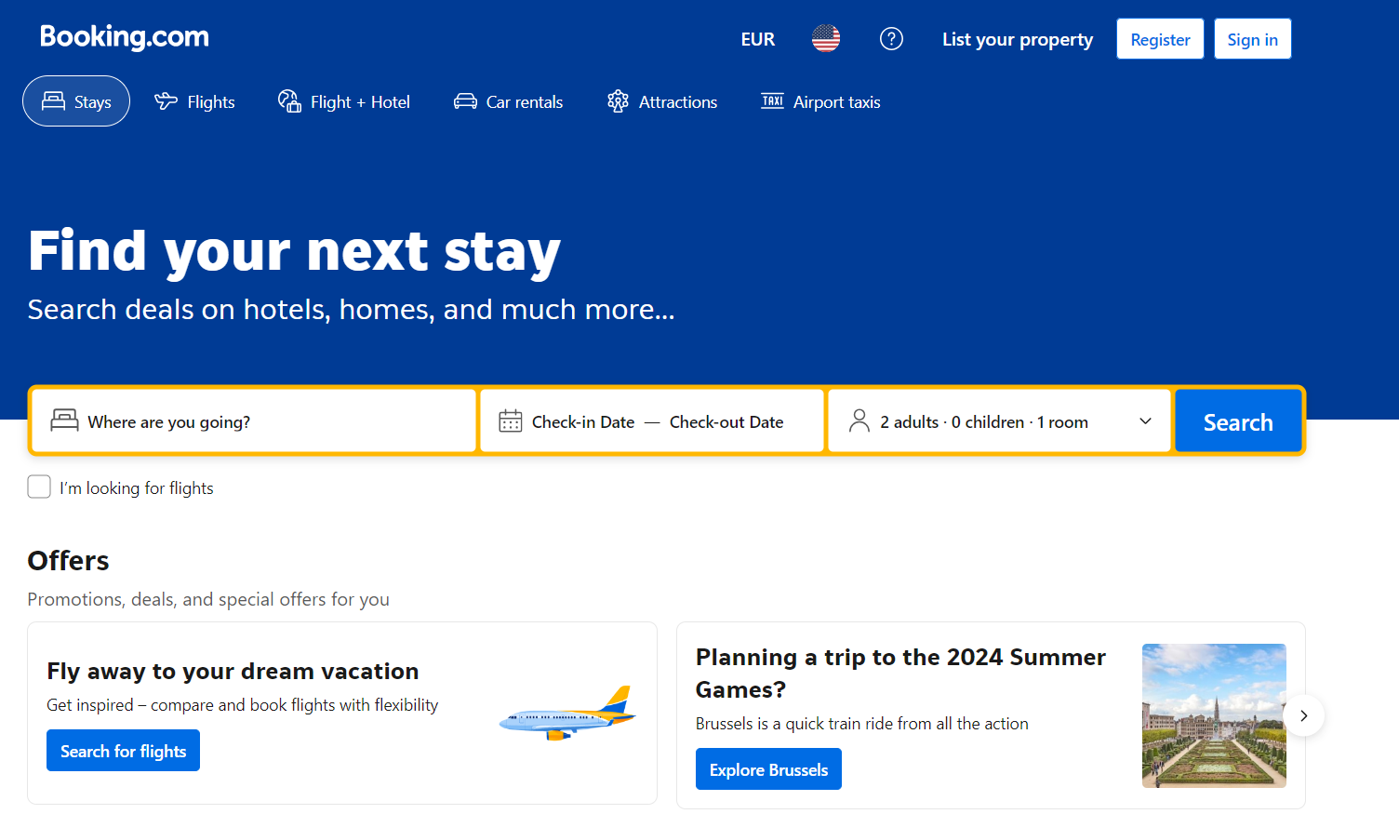
Data Scraping
We used beautiful soup library for scrapping
Our dataset contains about 8000 samples

Slide 5







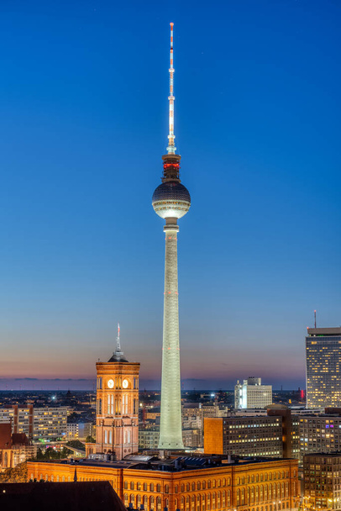
London
Paris
Madrid
Berlin

Slide 6

Data Scraping
Data Scraping
It is the process of extracting data especially from websites. It involves using automated tools or scripts to collect large amounts of data.
Scrape Hotels:
Initialize an empty list all_hotels to store hotel data.
Enter a loop to handle pagination:
Send a GET request to Booking.com with the defined headers and parameters.
Parse the HTML response with BeautifulSoup.
Extract hotel data from the current page using get_hotels_from_page.
Add extracted hotel data to all_hotels.
Increment the offset parameter to move to the next page.
Break the loop if no more hotels are found or after 20 pages.

Slide 7

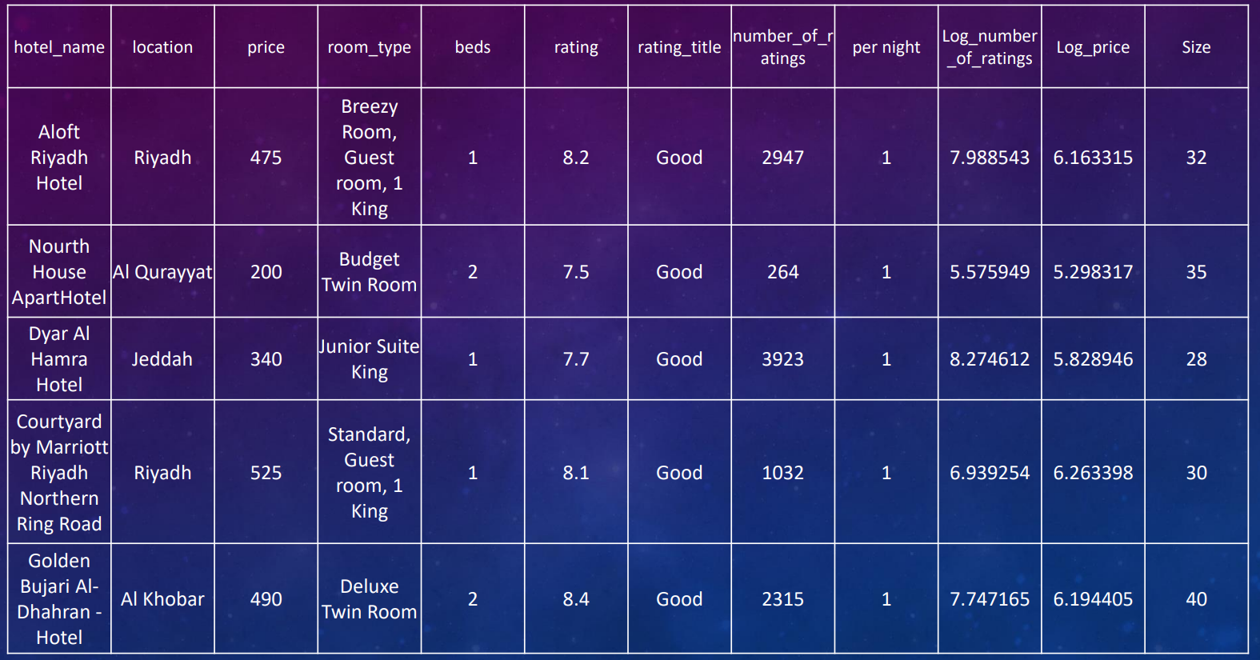
Data Sample

Slide 8

Description of all columns of the df
name: shows the name of the hotels in europe
location: indicates the "city" and the "neighbourhood" of that hotel
price: shows the price of hotel in US$.
rating: indicates the rate of the hotel from 10.
quality: shows the quality of the hotel
review: shows how many times this hotel has been reviewd.
bed: shows the number of the beds it has.
distance from centure: shows the distance of the from centure of the city.
room_type: shows the type of the room in the hotel that had been reserved.
nights: indicates the number of nights the room has been reserved.
adults: shows the room has been reserved for how many adults.

Slide 9

Feature Engineering

Slide 10

Feature Engineering
We focused on extracting specific components from "location" coulumn that containd 2 different information about the neighborhood and the city.
so we replace "location" with 2 different columns:
neighborhood
city

Slide 11

Feature Encoding
We numbered and encoded the categorical columns of our data, which had descriptive values ​​equal to the level of customer satisfaction, according to the average rating available for each descriptive category and the concepts we know from the English language.
Then we converted the values ​​that were stored in other columns dirty with extra punctuation marks or as strings.

Slide 12

Null Handling
We examined several methods to fill null values, among which the following methods can be mentioned:
Sorting based on address and using forward fill or back fill, this method did not create suitable values ​​for us
Using imputers such as KNN or RF to fill null values, these methods also did not provide good accuracy due to the high overhead of filling null values, as well as the number and distribution of null values ​​in the data, so they were not used.
Filling the missing values ​​with mean, median and mode, this method was used as a safe traditional method in the first step.
The use of interpolation methods, which also provided us with good accuracy.
Using the random sampling method from the column with zero values, this method also did not give us good accuracy because the zero values ​​in the categorical columns were few.

Slide 13
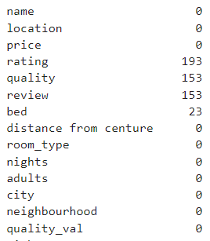
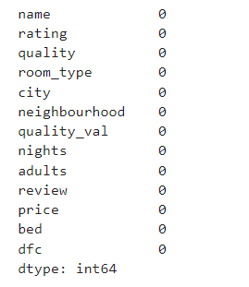
Null Handling
Initial df
final df

Slide 14

Explanatory Data Analysis

Slide 15

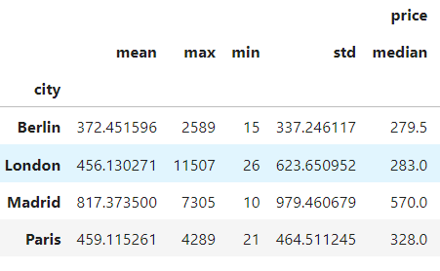
EDA
To find the attributes of each city and the attributes of the medita set, we grouped by city, point, and city and calculated different attributes for each attribute in that city.

Slide 16
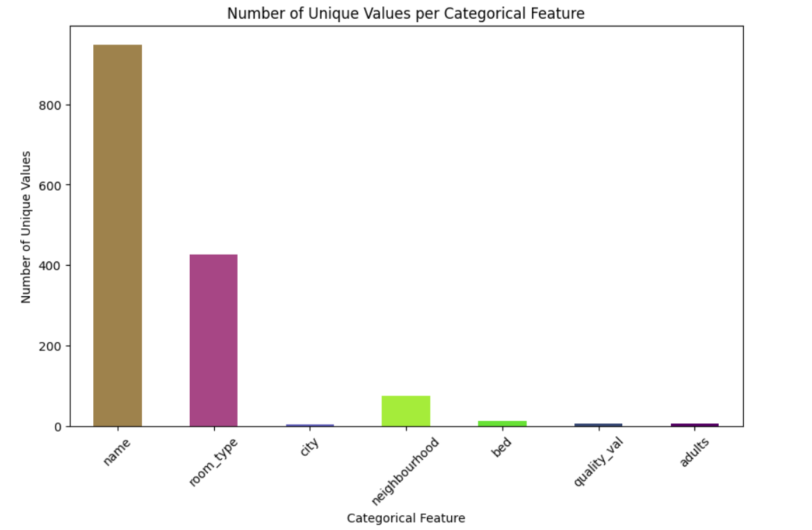
EDA
In this section, we calculated the number of unique values ​​in each column in order to know if the number of these values ​​is low or high, and also to identify the categorical ones.

Slide 17
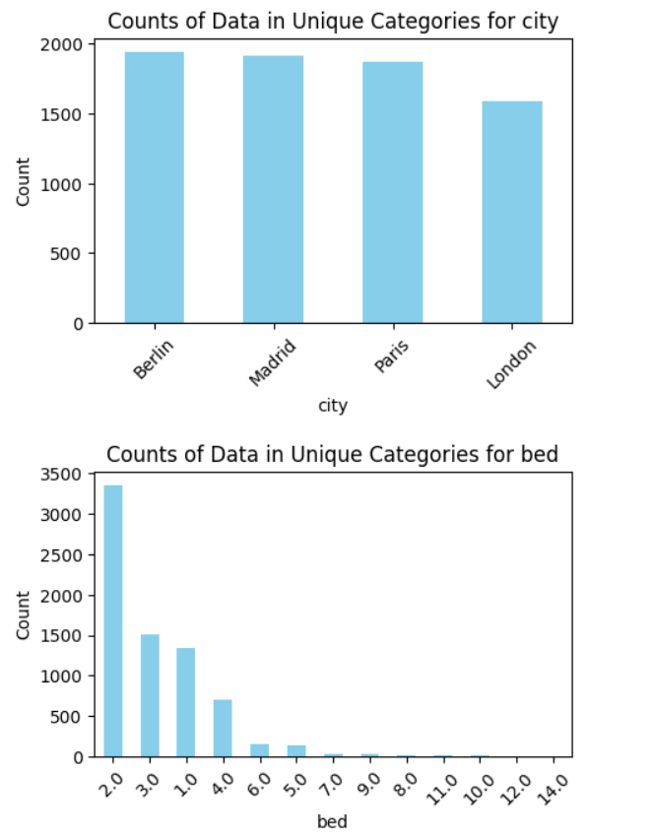
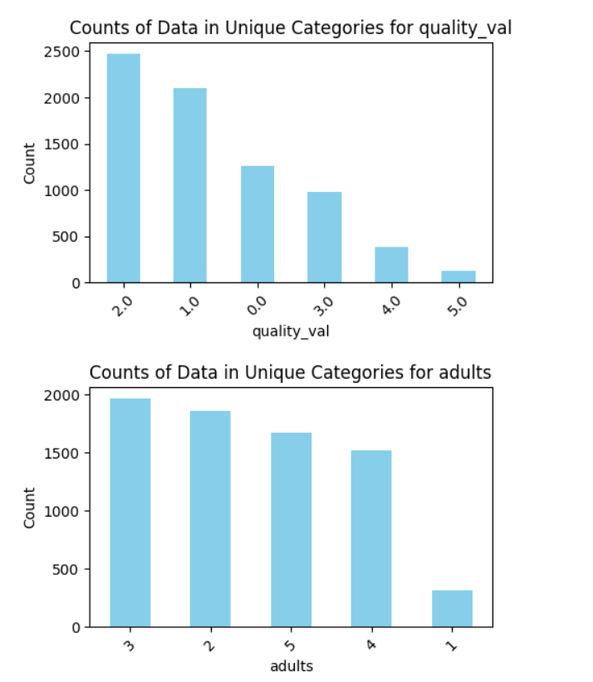
EDA
Now, for those columns that had a limited number of categories, we also calculated the number of data in each category.

Slide 18

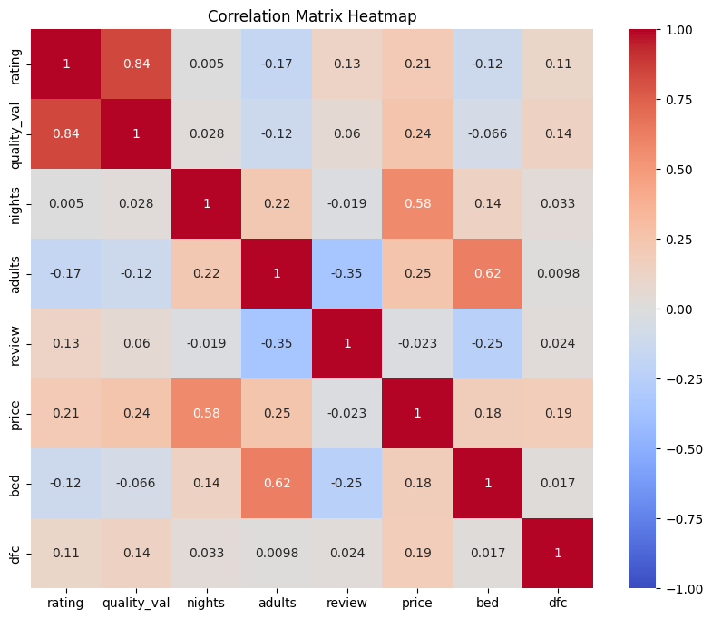
Correlation Matrix
The heatmap provides a quick visual summary of the relationships between all variables, allowing you to easily identify strong positive, strong negative, or weak correlations.
Identify patterns: You can see patterns in the correlations, such as groups of variables that are highly correlated with each other.

Slide 19

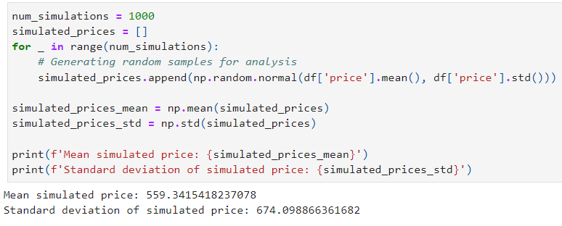
Monte Carlo Simulation
Price Analysis: Monte Carlo simulation can help generate different possible price scenarios based on the variability in the data. This can help in predicting the range of prices for different combinations of variables.

Slide 20
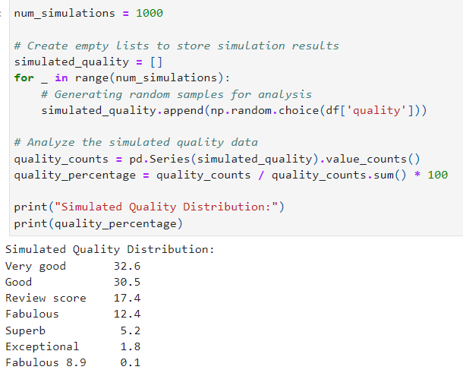
Monte Carlo Simulation
Quality Analysis: By simulating the quality variable in the DataFrame, Monte Carlo simulation can provide insights into the distribution of quality ratings, helping to identify patterns or outliers.

Slide 21
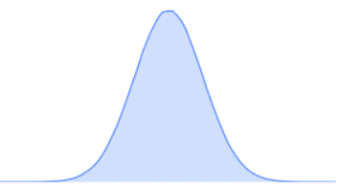
Central Limit Theorem
Rating: 95% Confidence Interval: (8.275, 8.363)
Inference: We can be 95% confident that the true average rating of listings in the population is between 8.275 and 8.363. This indicates that the average rating is quite high, around 8.3.
Quality_val: 95% Confidence Interval: (2.157, 2.295)
Inference: The true average quality value is likely between 2.157 and 2.295. This suggests a moderate quality rating on the given scale.
Nights: 95% Confidence Interval: (1.430, 1.510)
Inference: The average number of nights for a booking is between 1.430 and 1.510 nights. This suggests that most bookings are short-term, typically around 1.5 nights.
Adults: 95% Confidence Interval: (1.472, 1.552)
Inference: The true average number of adults per booking is between 1.472 and 1.552. This indicates that bookings are usually made for about 1.5 adults on average, often just one or two people.
Review: 95% Confidence Interval: (4408.453, 5254.196)
Inference: The true average number of reviews per listing is between 4408.453 and 5254.196. This high number suggests that listings are well-reviewed, indicating potentially high popularity or many transactions.
Price: 95% Confidence Interval: (284.153, 326.318)
Inference: The true average price of a listing is between 284.153and284.153𝑎𝑛𝑑326.318. This range gives us a good estimate of the typical cost, which appears to be in the mid-300 range.
Bed: 95% Confidence Interval: (1.102, 1.205)
Inference: The average number of beds per listing is between 1.102 and 1.205. This suggests that most listings offer slightly more than one bed, typically suitable for small groups or solo travelers.
Distance from Center (dfc): 95% Confidence Interval: (2.555, 8.570)
Inference: The average distance of listings from the city center is between 2.555 and 8.570 kilometers. This wide range indicates that listings vary significantly in their proximity to the center, with some being quite central and others farther away.

Slide 22

Hypothesis Testing
In this part our null hypothesis was distance from center of city has impact on price and rating.
P-value for both is less than 0.05
So null hypothesis rejected and we have linear relation between center of city and price also rating.

Slide 23
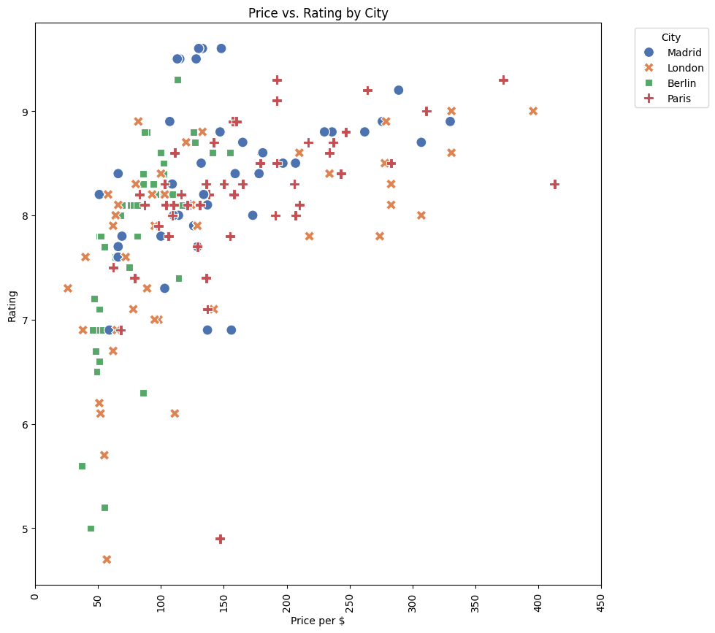

Visualization
Price and rating
For each hotels’ cities
Madrid has better hotels
London ,The most expensive hotels

Slide 24
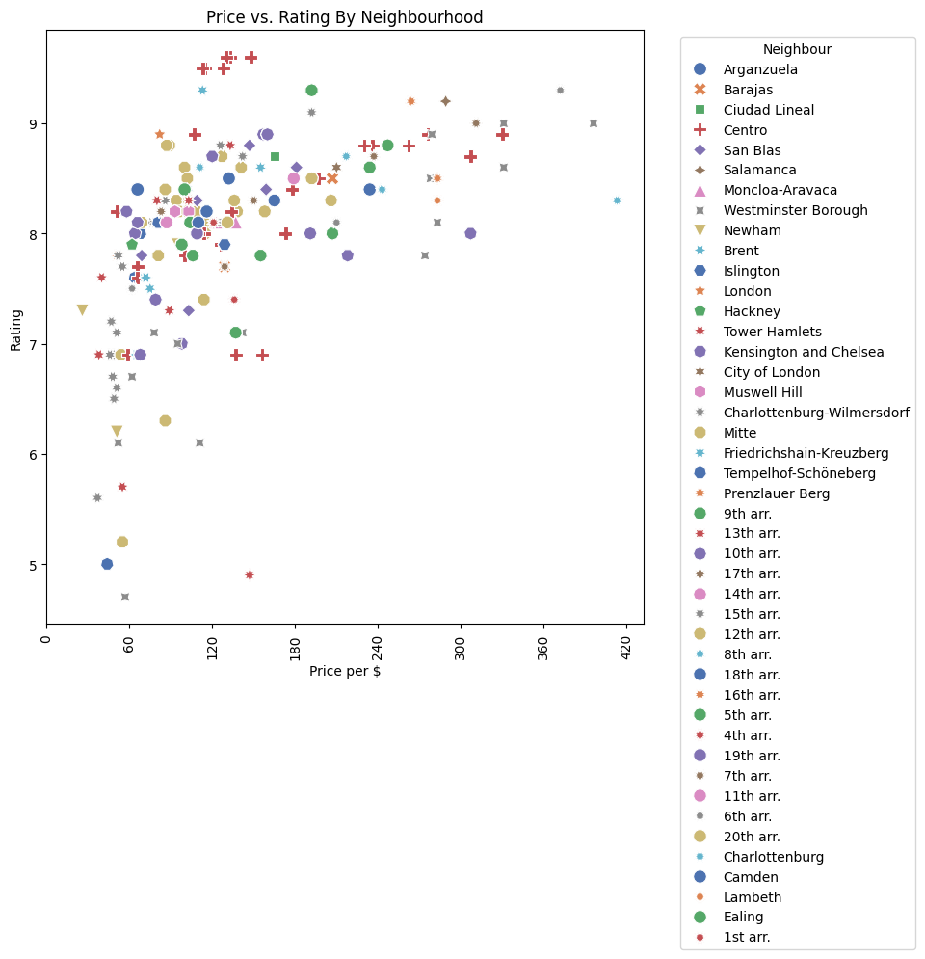
Visualization
All neighbors
We suggest Centro of Madrid
Westminster brough ,The most expensive hotels

Slide 25
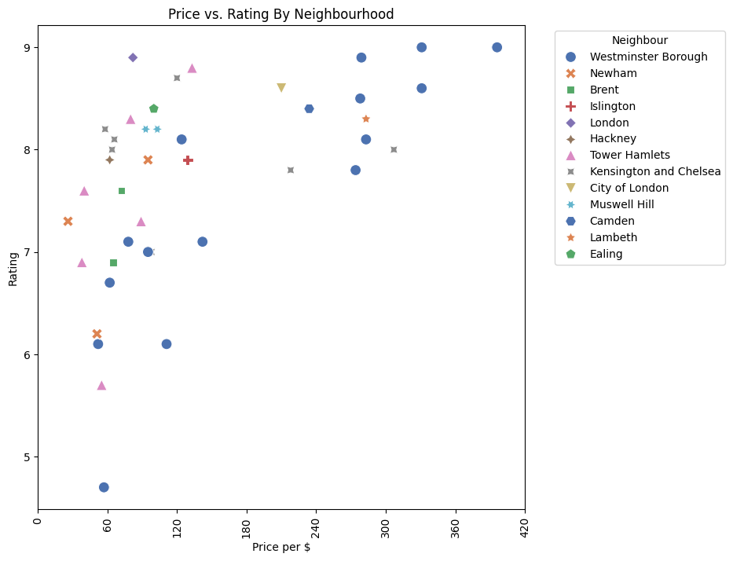

Visualization
London
Westminster brough ,The most expensive neighbors
Also low rating and cheap hotels are here
Other neighbors are appropriate

Slide 26
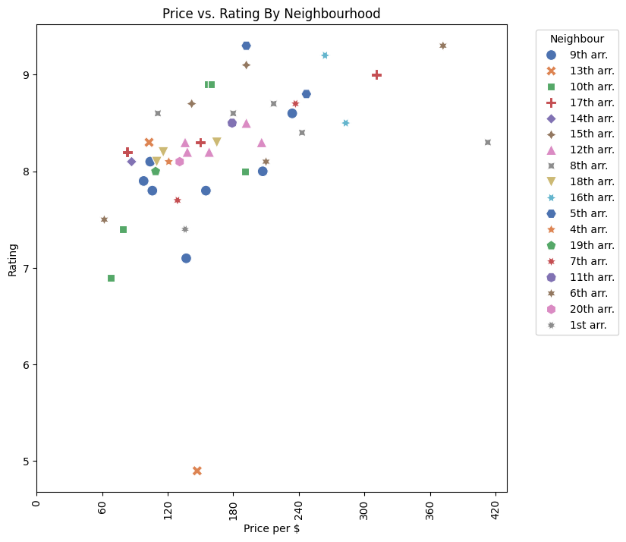

Visualization
Paris
The most expensive is 16h arr.
The cheapest is 10th arr.
All neighbors sound good for booking

Slide 27
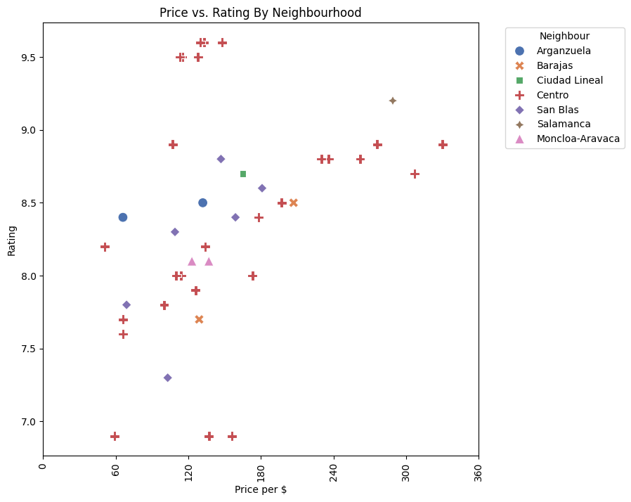

Visualization
Madrid
Most of information are from centro
Also the best hotels are over there

Slide 28
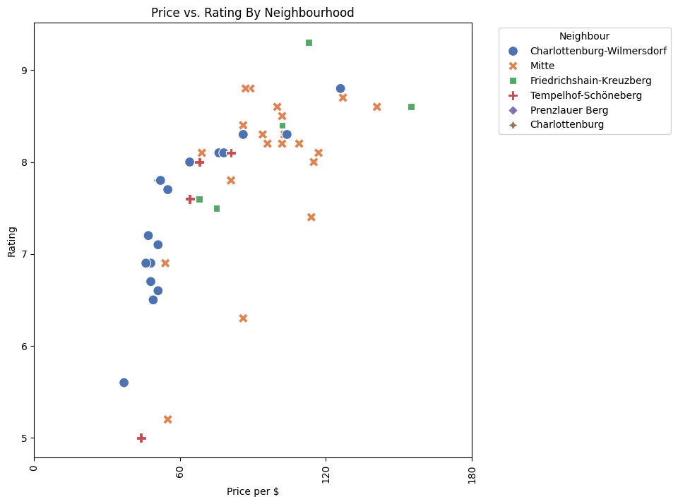

Visualization
Berlin
Mitte has better hotels
Also
Charlottenburg is not good idea

Slide 29

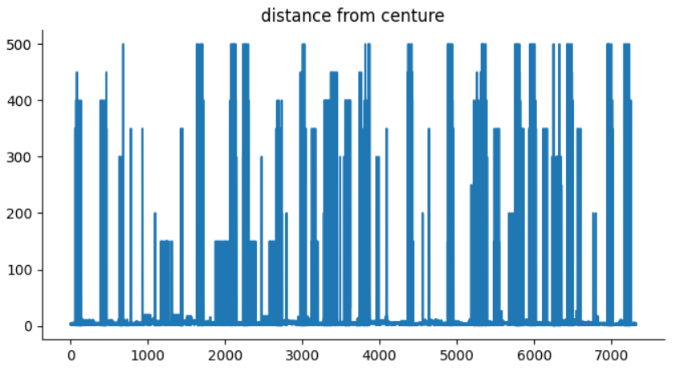
Visualization
it is a line graph titled "distance from center". The x-axis is labeled "each data" and the y-axis is labeled "counts".
The line graph displays the counts of data points at various distances from the center. The distance starts at zero and goes up to 600 in increments of 100.
However, we can see some general trends. The counts appear to be highest at a distance of 100 and then steadily decrease as the distance from the center increases. There appears to be a bit of a bump in counts around 400 distance units from the center. most of the hotels are located in the center of the city so that the distance from the hotels to the center of the city in most cases is equal to 0.

Slide 30
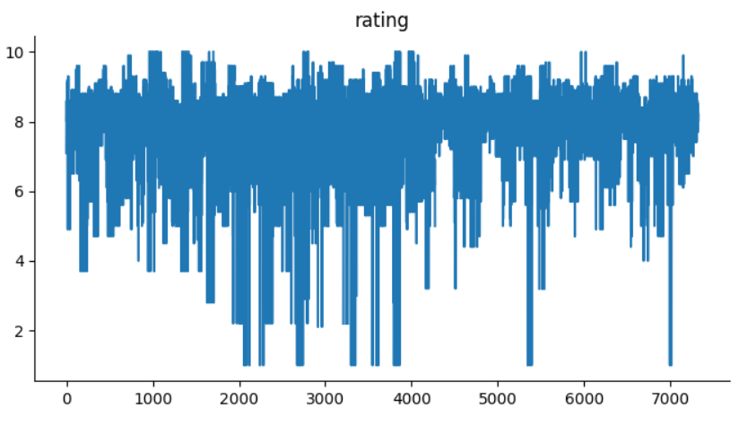
Visualization
In the specific image, the x-axis appears to represent each data and the y-axis appears to represent the value.
this show that the rating of the hotels are mostly between 7 - 9 but there are some hotels that are out of range and can be considered as outliers. for example one of tham has rating less than 5.

Slide 31
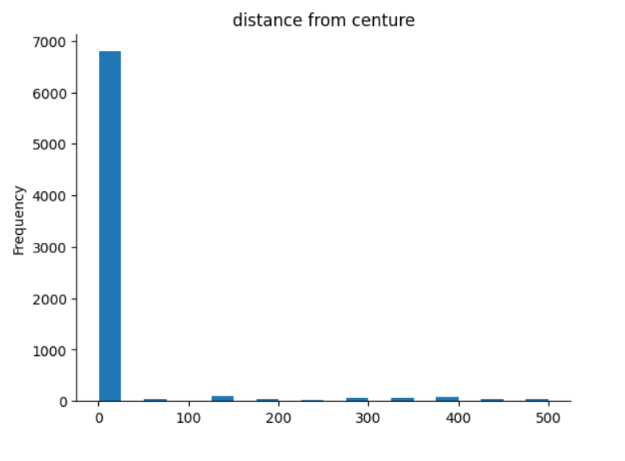
Visualization
it is a bar chart titled "distance from center". The x-axis is labeled "the hotel data" and the y-axis is labeled "distance from center". There are data points plotted for every week from 0 to 40.
The barchart shows the average distance from the center of a city. it shows that most of the hotels have 0 distance from the center of the city. in other words, most of them are located in the city center.

Slide 32
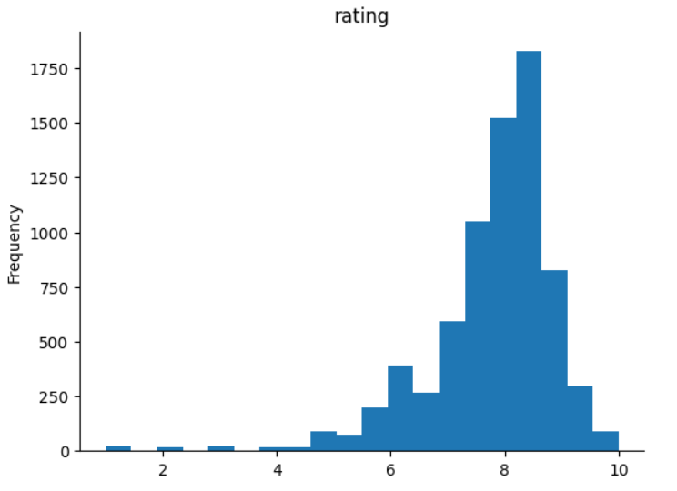
Visualization
this chart shows that the rating of the hotels has mostly been between 7 to 9. and are mostly between these numbers. here we can see some outliers that in some cases rating of a hotel has been 5 or some other number. and also in some points it has the most rating. the frequency of rating between 8-9 has been the most.

Slide 33
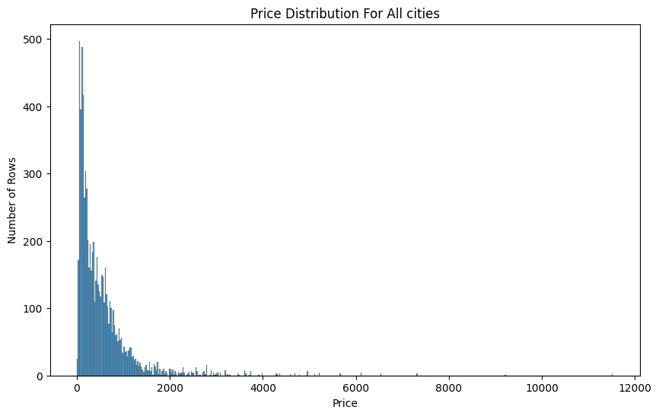
Visualization
It is histogram plot for price all hotels in these four cities.
As we see it is right skewed like salary distribution.

Slide 34
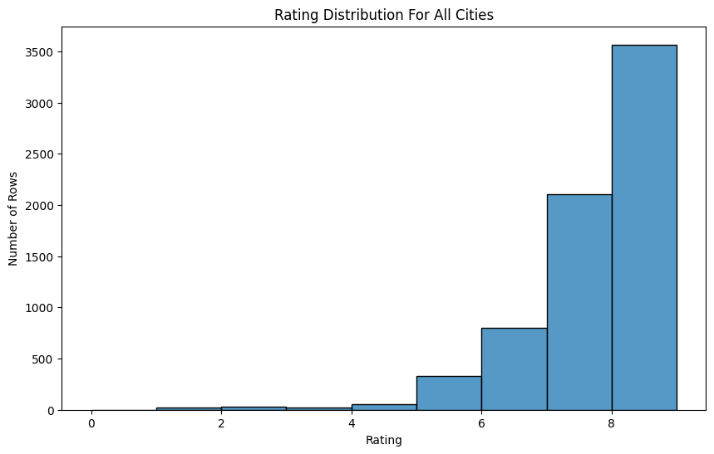
Visualization
It is histogram plot for rating all hotels in these four cities.
As we see it is left skewed

Slide 35
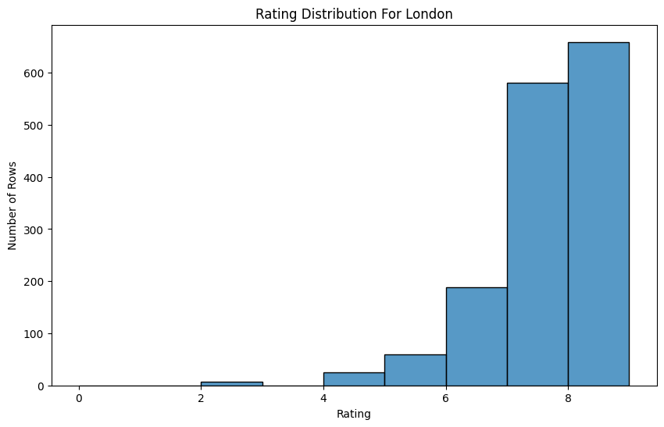
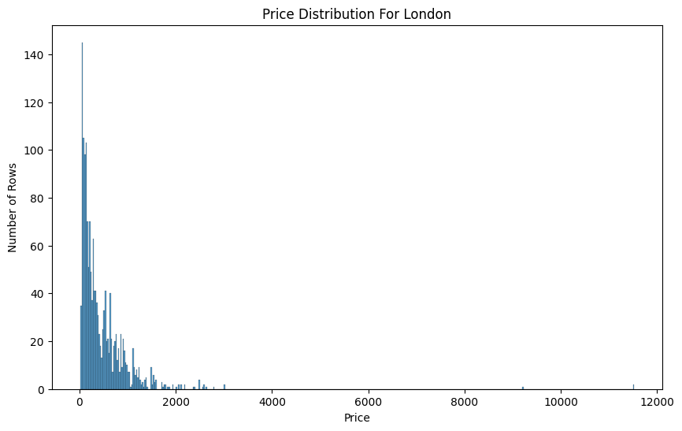
London
Rating and Price distribution

Slide 36
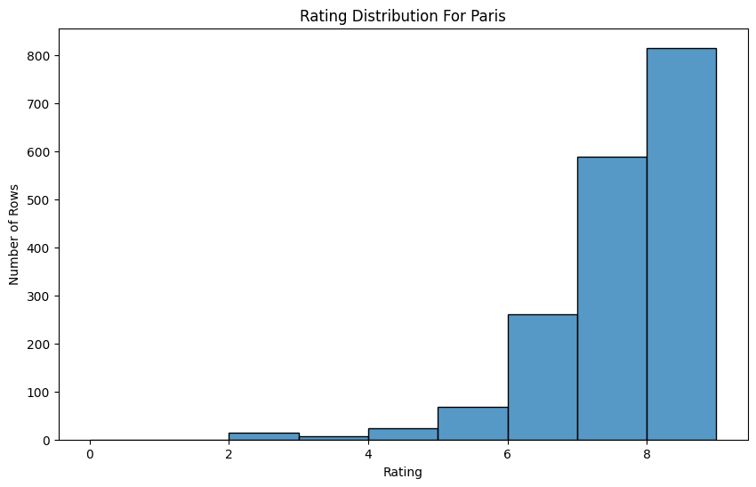
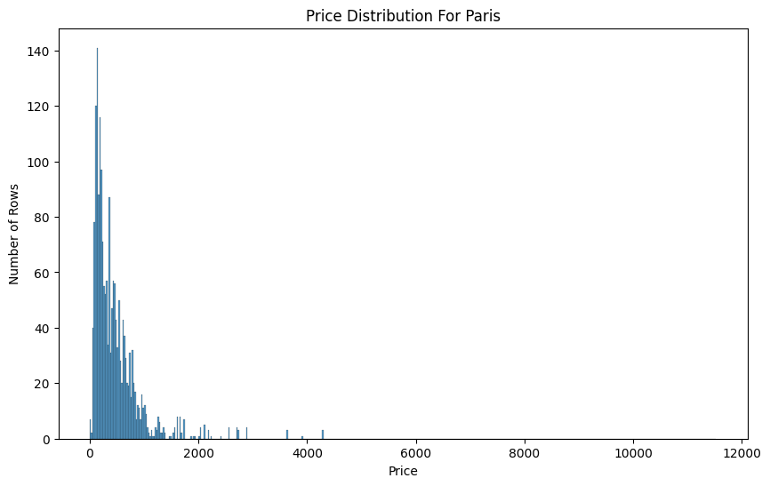
Paris
Rating and Price distribution

Slide 37

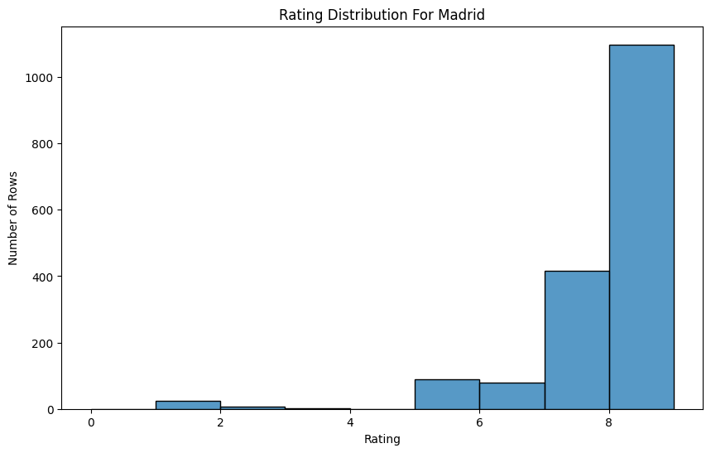
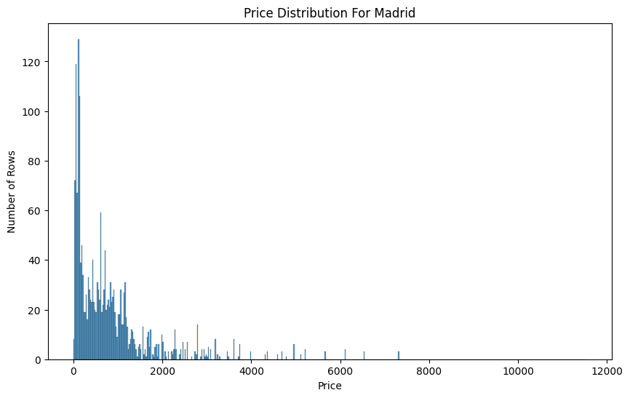
Madrid
Rating and Price distribution

Slide 38

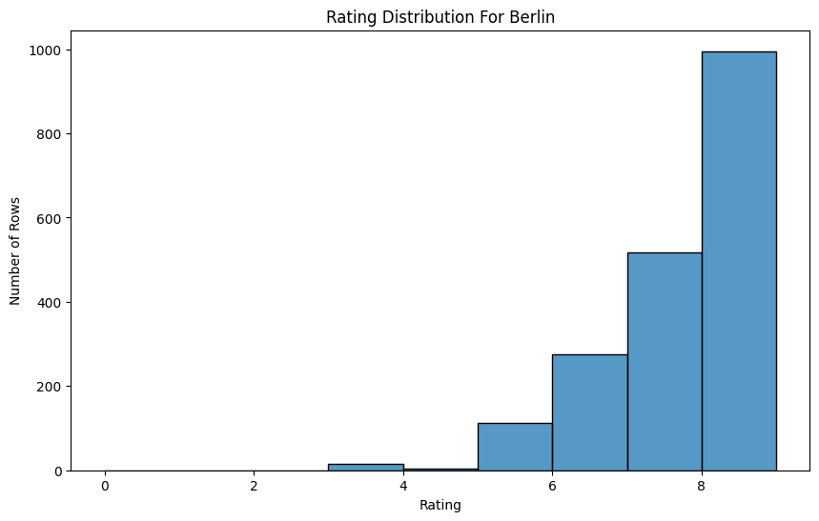
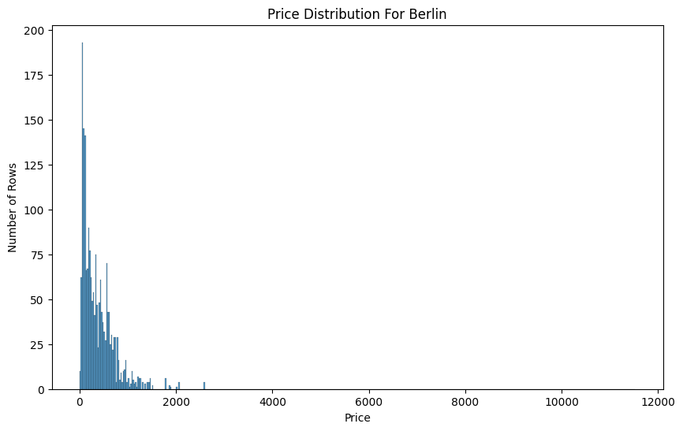
Berlin
Rating and Price distribution

Slide 39
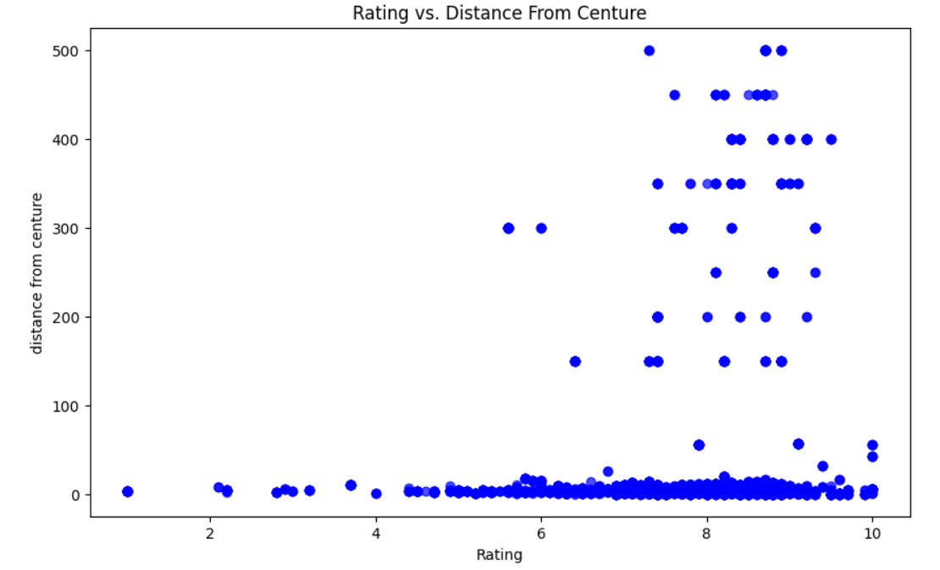
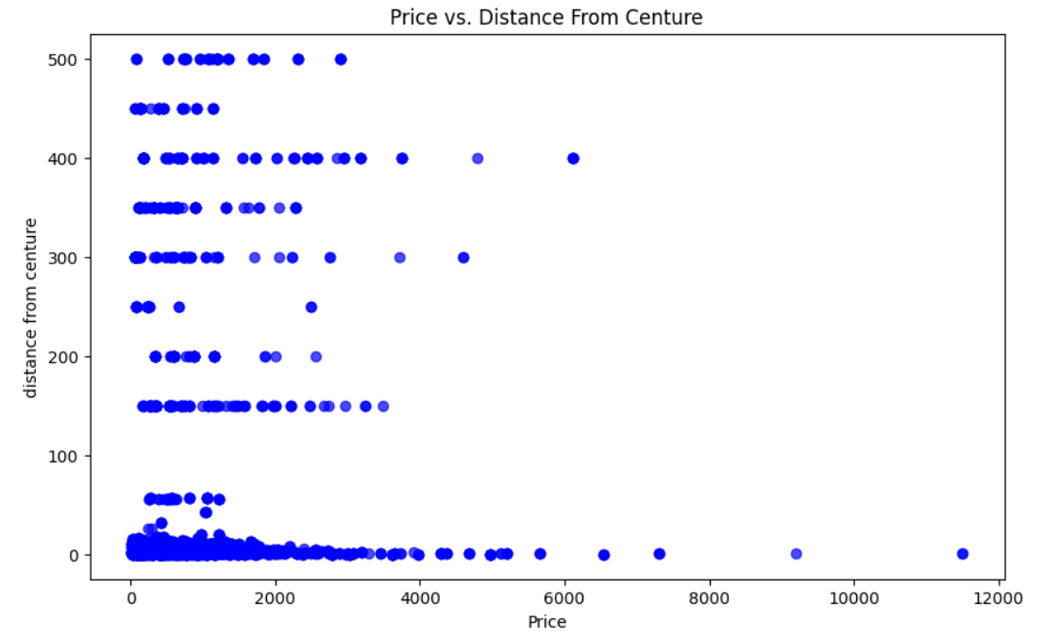
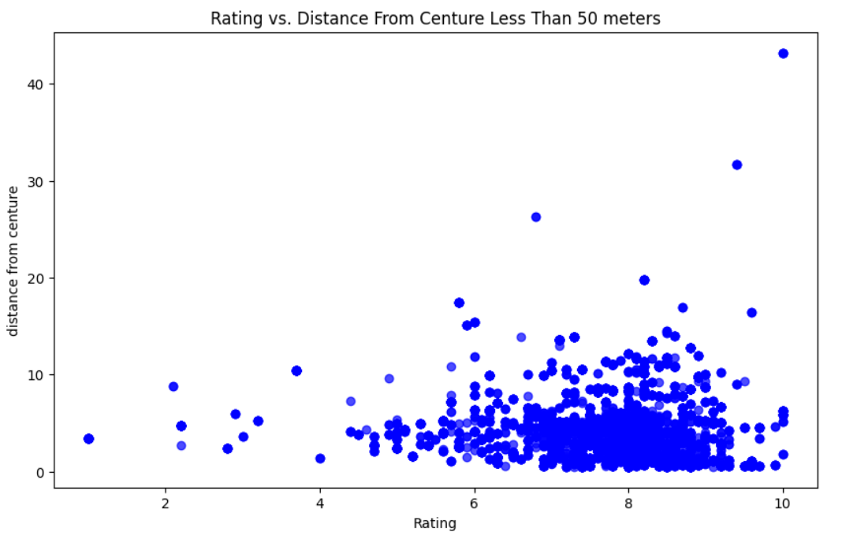
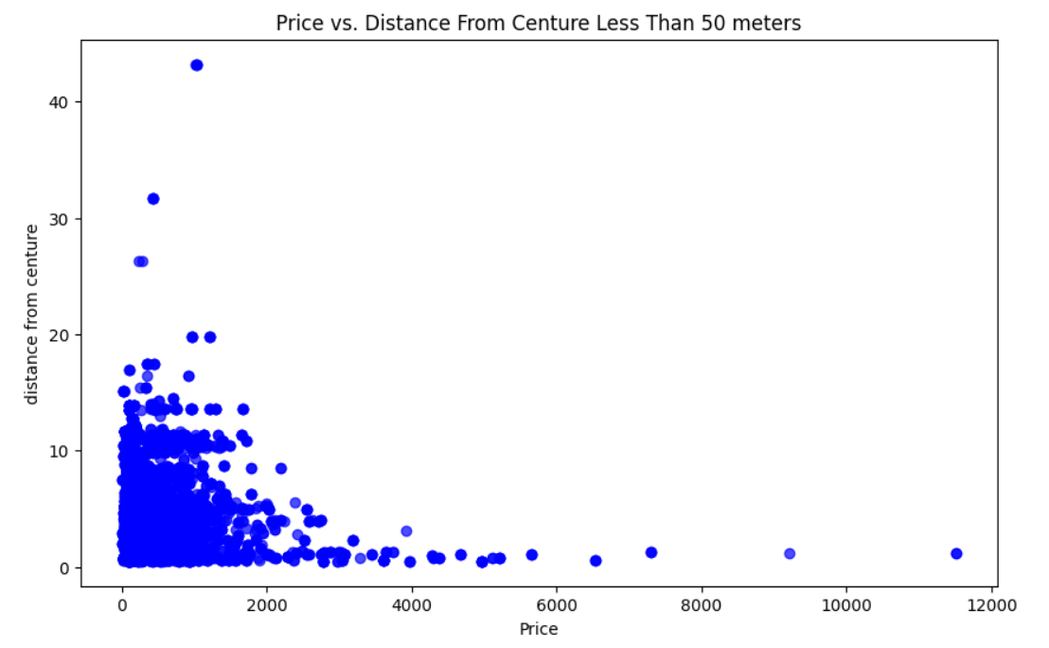
Visualization (Scatter Plot of Distance From Center)
The best hotels are in center of cities mostly.
Far hotels from center of city are cheaper.
Don't worry about the poor quality of hotels by moving away from the city center
So if you want cheaper hotel far places sound good idea.

Slide 40
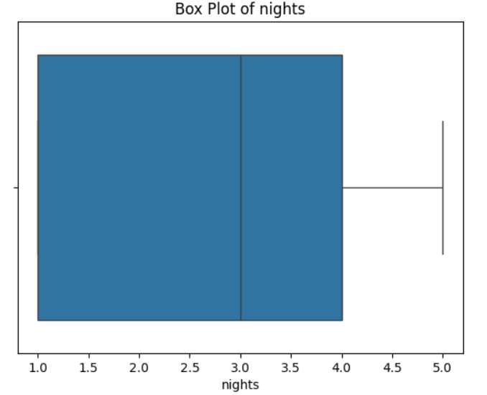
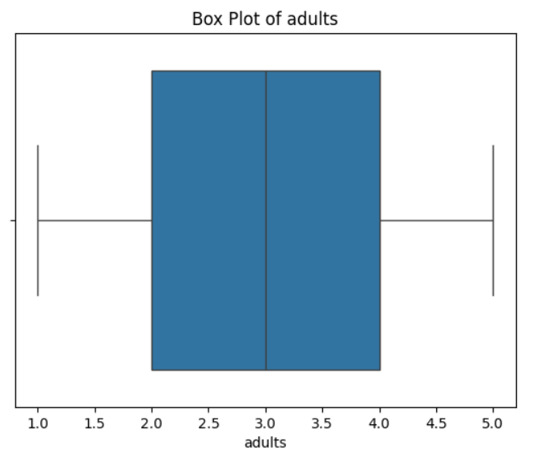
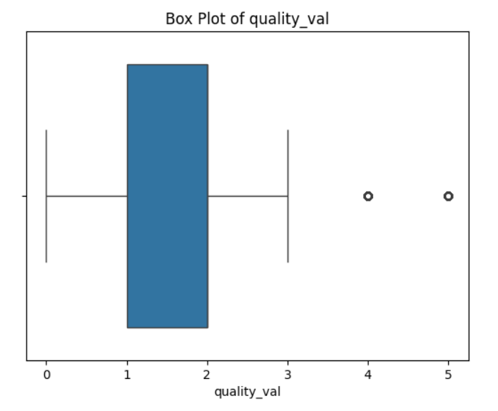
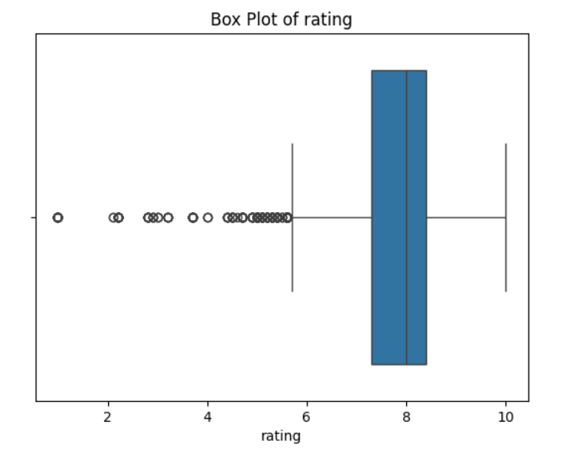
Visualization (Box Plots)
The number of nights and adults are relatively stable with no outliers.
The quality value has a few higher outliers, suggesting variability in the quality ratings provided.
The ratings show a notable number of lower outliers, which could indicate occasional dissatisfaction among some guests despite the generally high median rating.
There are numerous outliers below the rating of 6, showing that while most ratings are high, there are some significantly lower ratings present in the dataset.
There are several outliers above the value of 4, indicating some higher quality values that are not common in the dataset.

Slide 41
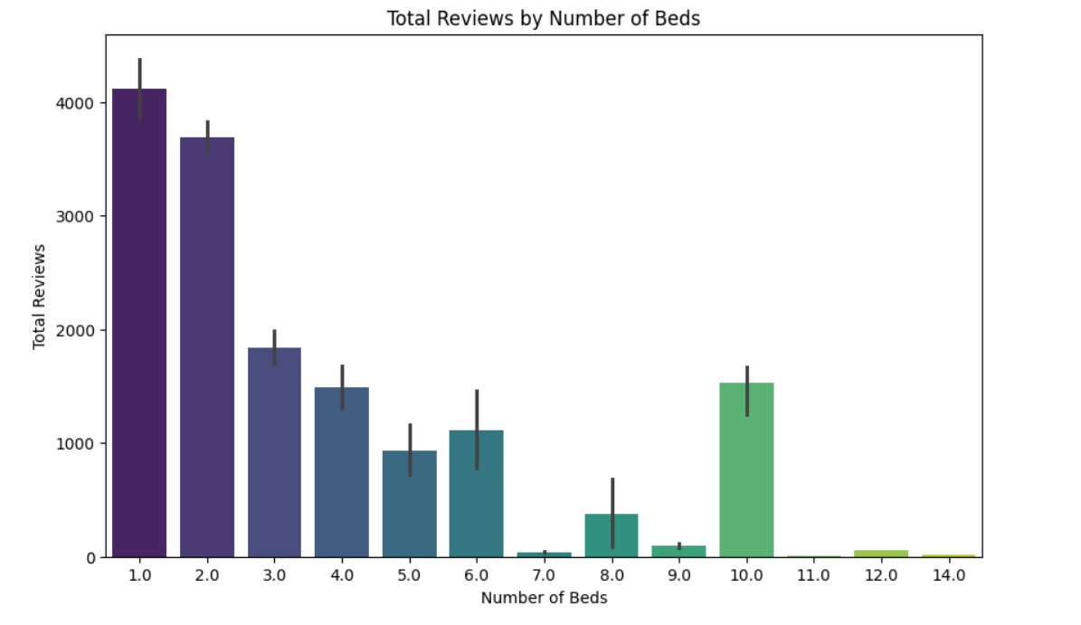
Visualization
Rooms with two beds have more reviews maybe because pepole in travel are family are group , so these reservations are more than ets.
And maybe because reaction in groups or family are more than solo or couple and reactions are more.

Slide 42
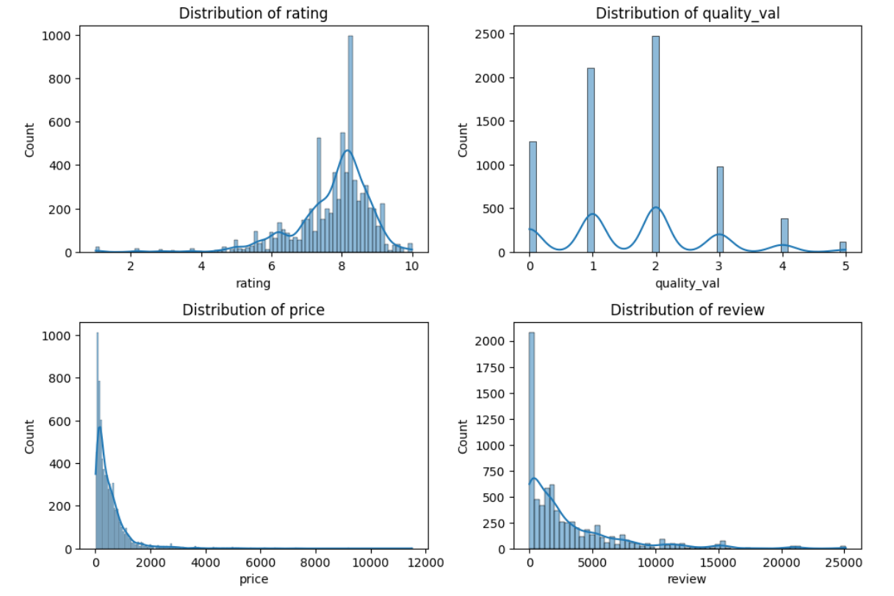
Visualization (Distributions)
The rating distribution shows a positive skew, indicating that most guests rate their experiences highly.
The quality values are assigned in discrete categories, with most properties falling in the middle categories.
Both price and review distributions are right-skewed, indicating that while most properties are priced reasonably and have a moderate number of reviews, there are a few properties that are significantly more expensive or have an unusually high number of reviews.
There are some properties with an exceptionally high number of reviews, reaching up to 25000, but these are outliers.
The price distribution is heavily right-skewed with a long tail. Most prices are concentrated below 2000 units, with a sharp drop-off as prices increase. A few data points show prices as high as 12000 units, but these are rare.

Slide 43


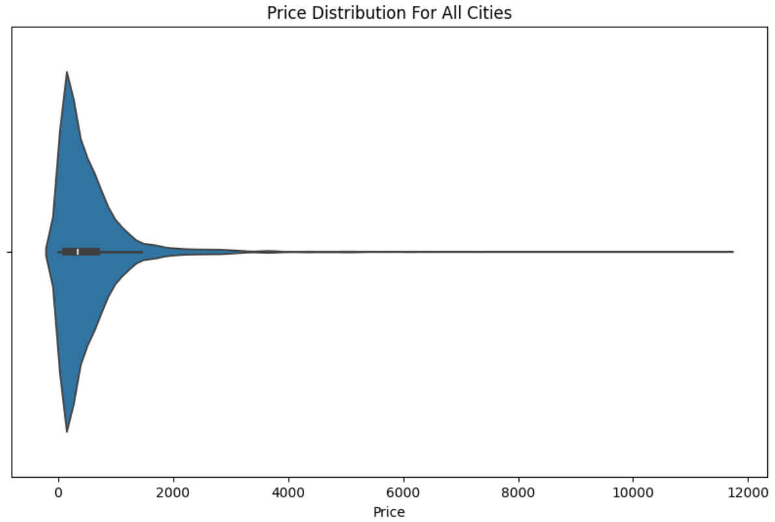
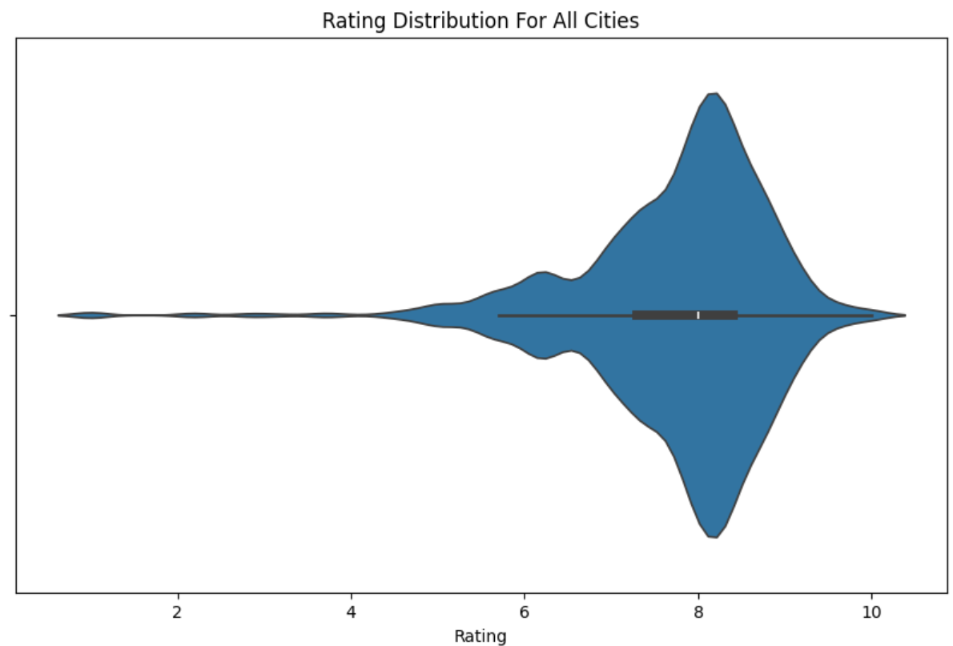

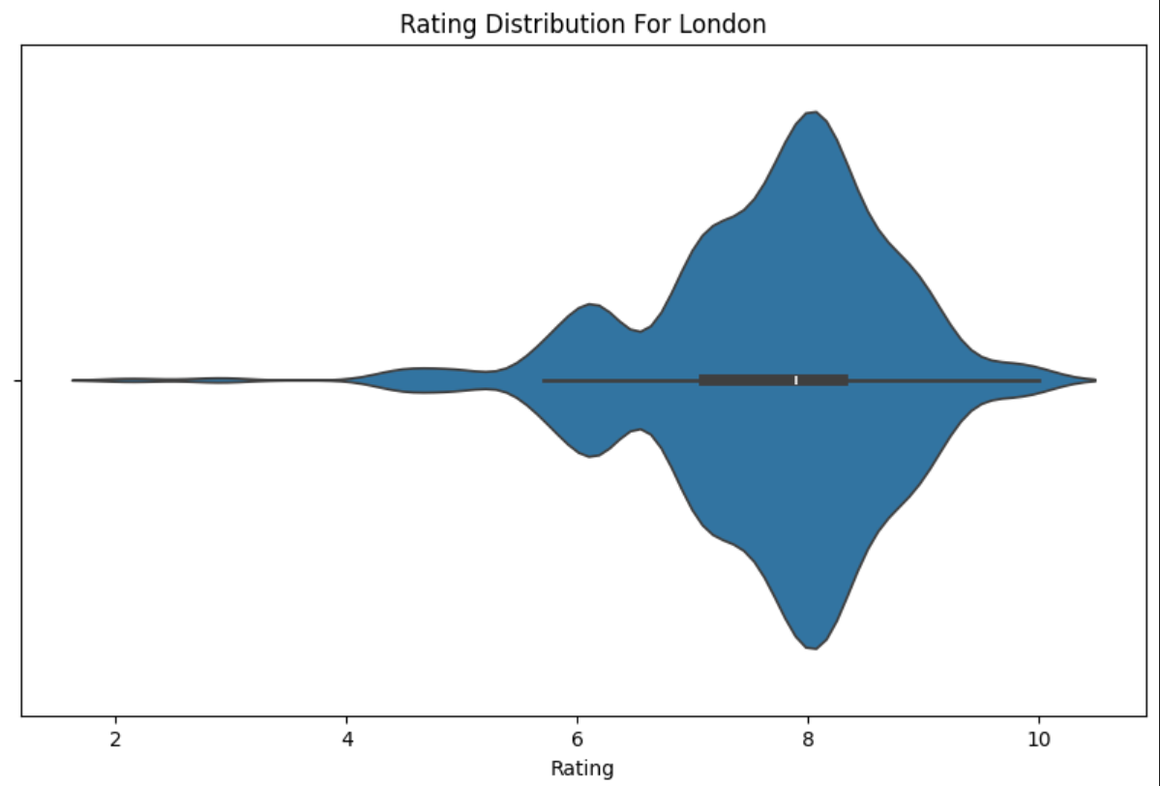
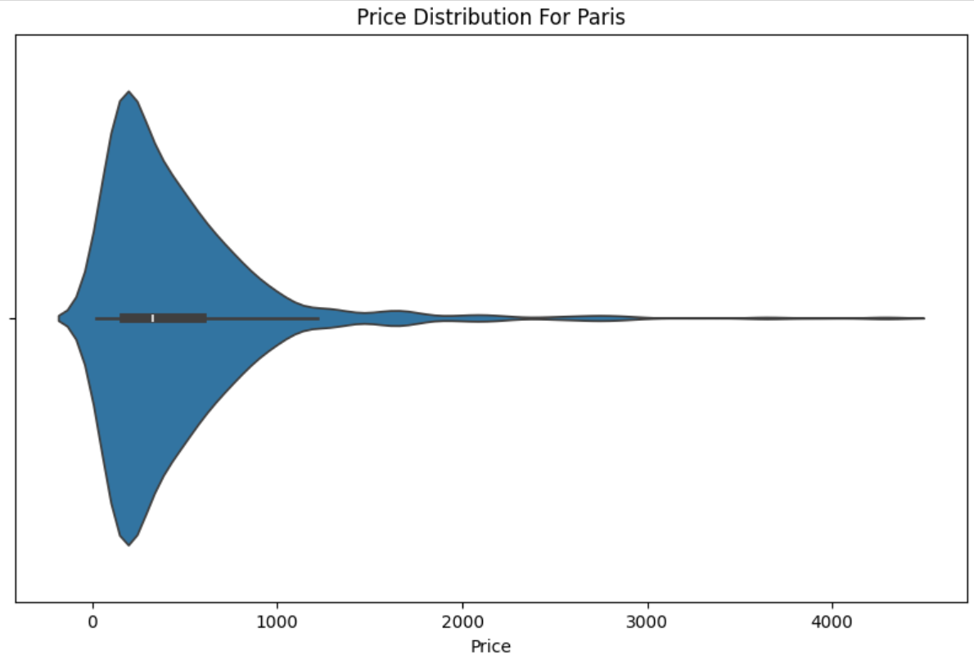
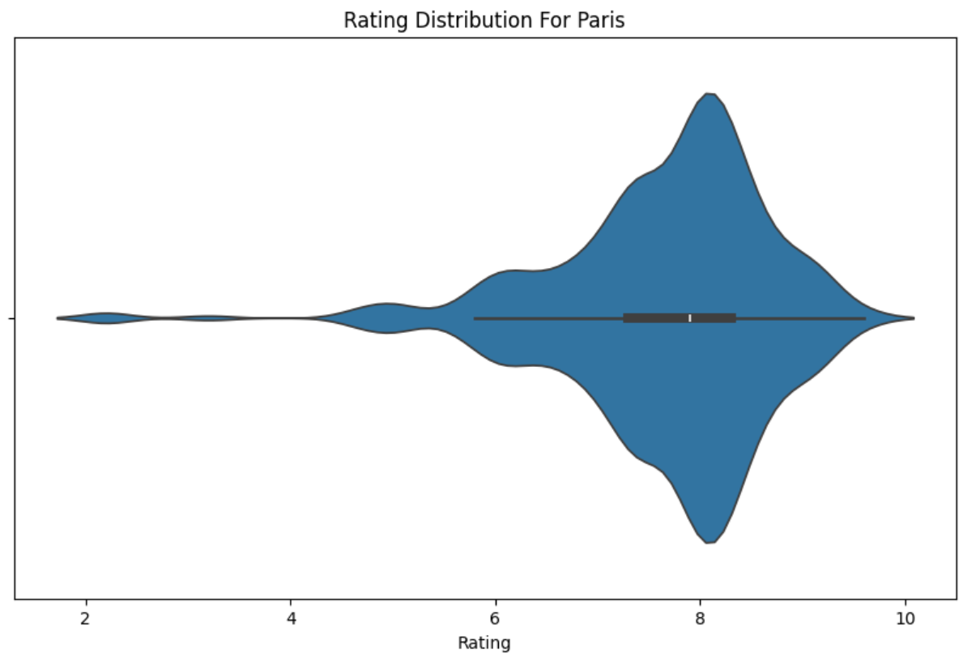
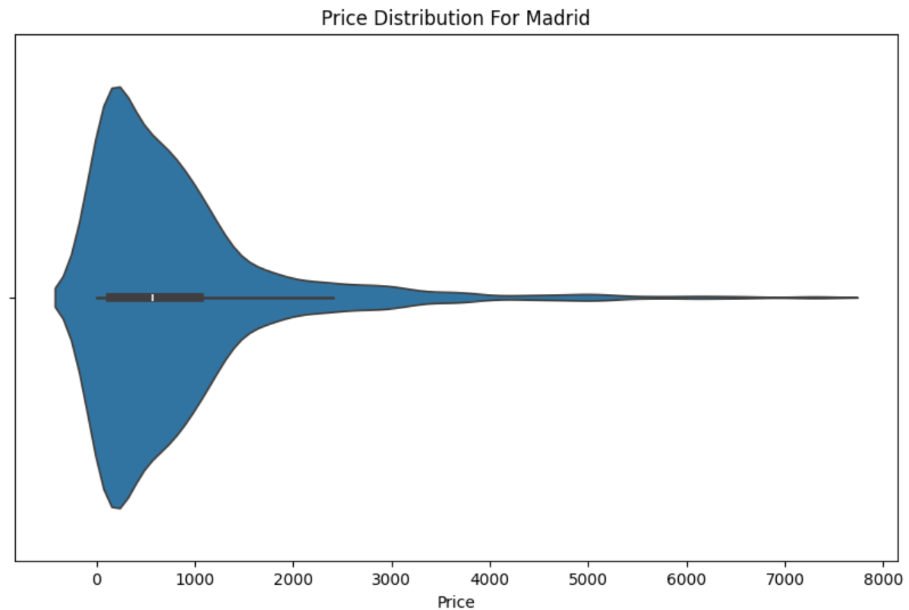


Slide 44

Visualization (heatmap)
Number of nights and quality heat map
Red colors means higher price and vice versa

Slide 45

Visualization (heatmap)
Number of nights and quality heat map
Red colors means more distance from center of city and vice versa

Slide 46
OLS Result
- Rating: A highly significant positive effect (coef = 6.836e+05) indicating that higher ratings substantially increase the price.
- Quality value: Significant negative effect (coef = -2.537e+05), meaning that higher perceived quality decreases the price, which might suggest higher quality properties are priced lower to attract more bookings.
- Nights: Significant positive effect (coef = 817.50) suggesting that longer stays are associated with higher prices.
- Adults: Significant positive effect (coef = 533.70) indicating that the price increases with the number of adults.
- Review: Significant negative effect (coef = -165.95), meaning that better reviews lead to lower prices, which might indicate competitive pricing strategies.
-------------------------------------------------------------------------------------------------------------------------------------------------
- Various specific property names significantly influence the price, either positively or negatively. For example:
- Positive Effects:
- "134 Kilburn road apartment" (coef = 9.549e+04)
- "250 City Road 2 Bollinder Place" (coef = 6.274e+04)
- Negative Effects:
- "Suite Ober - Superbe Appartement à Paris" (coef = -1.75e+05)
- "2 Bed 2 Bath Close to Big Ben" (coef = -4.607e+05)

Slide 47


















Tnx 4 your attention
Have a nice trip!

